Slide 1

An Automatic Detection of Breast Cancer Diagnosis and Prognosis Based on Machine Learning Using Ensemble of Classifiers
SRINIVASA INSTITUTE OF ENGINEERING AND TECHNOLOGY (A)
DEPARTMENT OF
COMPUTER SCIENCE AND ENGINEERING
Submitted by:
Sk.Lehimsha(206N1A0553)
T.Sunitha(206N1A0555)
P.Suchitra(206N1A0544)
CH.Satya Surya Prakash(206N1A0504)
Under the guidance of:
Mr.B.Arun Kumar, Mtech,(Ph.D)
Associate Professor

Slide 2
CONTENTS:
Abstract
Introduction
Existing system
Proposed system
Specifications
Algorithms
Architecture
Implementation
Use case diagram
Sequence diagram
Class diagram
Collaboration diagram

Slide 3
ABSTRACT
This project addresses the critical need for early detection of breast cancer (BC), the second leading cause of death among women. Recognizing the significance of early diagnosis in improving prognosis, this study introduces an automated BC detection system employing a diverse ensemble of machine learning classifiers. Investigating various ML algorithms and ensemble techniques, including Artificial Neural Networks (ANN), the study evaluates their efficacy using benchmark datasets. Demonstrating superior performance, the ensemble method achieved high accuracy, surpassing existing methods. The proposed system holds immense promise for the medical industry, offering a highly accurate, efficient tool for BC diagnosis and prognosis, crucial for improving patient care and outcomes.

Slide 4
AIM
An automated system using machaine learning to enhance early detection of breast cancer for improved prognosis and treatment
OBJECTIVE
To develop and assess an ensemble-based machine learning system for efficient and accurate automatic diagnosis and prognosis of breast cancer, aiming to enhance early detection and treatment outcomes.

Slide 5
MOTIVATION
The urgency to reduce breast cancer mortality through early detection propels the development of an accurate, swift, and reliable system, leveraging machine learning, to revolutionize diagnosis, prognosis, and treatment outcomes for patients and the medical community.
PROBLEM STATEMENT
The challenge lies in enhancing breast cancer diagnosis timeliness and accuracy. Developing an automated system utilizing machine learning aims to address this critical issue for improved patient prognosis and healthcare efficiency.

Slide 6
SCOPE OF WORK
This project's scope involves developing an ensemble-based system using machine learning for automated breast cancer diagnosis and prognosis, assessing various algorithms' effectiveness on benchmark datasets for enhanced healthcare outcomes.

Slide 7
INTRODUCTION
The dominance and impact of breast cancer globally, especially among women, underscore the urgency for enhanced detection and prognosis. Manual interpretation of mammograms, despite advancements in computer vision, poses challenges due to the sheer volume of screening images. With breast cancer accounting for a significant percentage of diagnosed cases and mortality rates, early identification remains pivotal. Timely diagnosis significantly influences survival rates, making accurate classification of benign and malignant tumors crucial. Leveraging machine learning, this study delves into various classification algorithms, emphasizing artificial neural networks (ANN) in deep learning and traditional methods like support vector machines (SVM), k-nearest neighbor (KNN), and decision trees (DT) to advance breast cancer detection and classification.

Slide 8
EXISTING SYSTEM
Breast cancer is one of the deadly disease and currently 100% curable is not available and time diagnosis or prediction can help in reducing risk and to predict such disease many machine learning algorithms were introduced but their prediction accuracy either not good or easily over-fitted which result into inaccurate prediction.

Slide 9
DISADVANTAGES
Limited accuracy in predictions.
Risk of inaccurate diagnoses.
Dependency on quality data.
Sensitivity to data imbalances.
Variability in prediction outcomes.

Slide 10
PROPOSED SYSTEM
To overcome from above problem author of this paper is using ensemble (list of classifiers) classifiers to train two different datasets and then evaluate their performance in terms of accuracy and to get better result author has experiment ensemble algorithm with and without up-sampling (generate new records for class which contains fewer instances to balance dataset). Experiment with various classifiers proofs that algorithms trained on up-sampling data giving better accuracy.
In propose author using ensemble algorithms such as SVM, Logistic Regression, Random Forest, Decision Tree and Naïve Bayes and all this algorithms stack or ensemble using Stack classifier. Stack classifier trained all algorithms and then choose only those algorithms which is giving better accuracy. Predicted values get trained with ANN algorithm to further enhance prediction accuracy. Apart from ensemble and ANN classifier author has used Deep learning algorithm and all this algorithms are giving more than 95% accuracy on up-sample dataset.
.

Slide 11
ADVANTAGES
Enhanced accuracy in diagnosis.
Quick detection capability.
Potential for prompt treatment.
Improved prognosis accuracy.
Significant medical industry relevance.

Slide 12
SPECIFICATIONS
Operating system : Windows 10 or 11
RAM :8 GB
Hard disc or SSD : 500 GB
Processor : Intel 3rd generation or high
Software : Python 3.7 or high version
Software’s : Jypyter Notebook

Slide 13
ALGORITHMS
SVM
Logistic Regression
Random Forest
Decision Tree
Naïve Bayes
ANN
XGBOOST algorithms

Slide 14
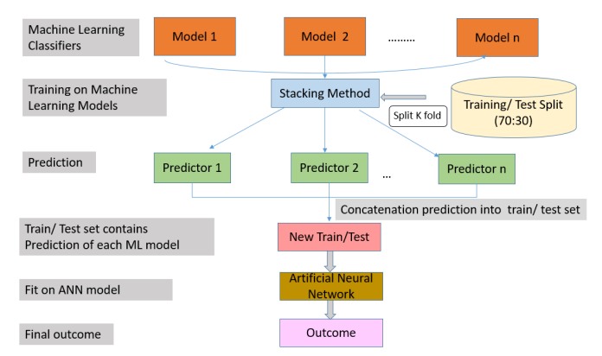
ARCHITECTURE

Slide 15
Implementation
1. Dataset Preprocessing
The dataset is loaded using Python's Pandas library, and missing values are handled by replacing them with zeros.
Features are encoded using LabelEncoder to convert categorical data into numerical format.
The dataset is split into features (X) and labels (Y).
2. Data Upsampling
To handle class imbalance, the Synthetic Minority Over-sampling Technique (SMOTE) is applied to upsample minority classes.
Upsampling generates synthetic samples to balance the class distribution.
3. Train-Test Split
The dataset is split into training and testing sets using a 80-20 ratio.
Both original and upsampled datasets undergo the same split process.

Slide 16
Implementation
4. Model Training
Various ensemble classifiers are constructed using different combinations of base classifiers such as Support Vector Machines (SVM), Logistic Regression (LR), Naive Bayes (NB), Random Forests (RF), and Decision Trees (DT).
Stacking Classifier is implemented to combine the predictions of base classifiers and train an additional Artificial Neural Network (ANN) model using the stacked predictions as input features.
Deep Learning models using Convolutional Neural Networks (CNN) are trained separately for both diagnosis and prognosis datasets.
The ANN models are trained using Keras with appropriate configurations like activation functions, dropout layers, and optimizer.

Slide 17
Implementation
5. Evaluation
The trained models are evaluated using accuracy scores on both original and upsampled datasets.
Confusion matrices and other relevant evaluation metrics are computed to assess the performance of each model.
XGBoost classifiers are also trained to compare their performance with the ensemble and deep learning models.
6. Results
Accuracy scores and performance metrics of each model are tabulated for comparison.
Results help in identifying the most effective model for medical diagnosis and prognosis tasks.
Performance metrics provide insights into the strengths and weaknesses of each model.
Performing prediction on test data .. value as Benign or Malignant

Slide 18
USE CASE DIAGRAM

Slide 19
SEQUENCE DIAGRAM

Slide 20
CLASS DIAGRAM

Slide 21
COLLABORATION DIAGRAM

Slide 22
Thank You

